Slide 1
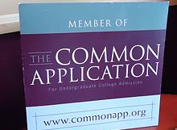
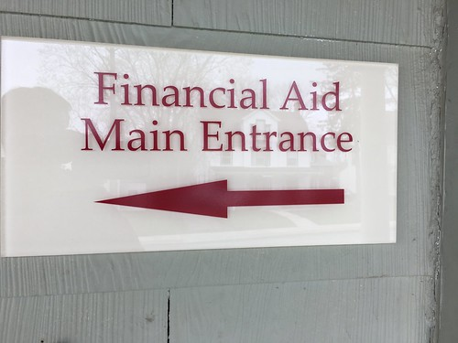
JUMPSTART COLLEGE ADMISSIONS
CLASS OF 2024

Slide 2
Today’s Presenters
Navigating Naviance and the Application Process
Mrs. Pimental, Counselor (A-Kl)
spimental@marisths.org
(541)686-2234 ext 1523
Mr. Copley, Counselor (Km-Z)
jcopley@marisths.org
(541)686-2234 ext 1522

Slide 3
The Coach
Ask
Ask insightful and helpful questions - encourage your student to think broadly
Assist
Assist with research of schools, deadlines, and scholarships
Encourage
Encourage the necessary hard work required to prepare and pursue goals
Help
Help create and monitor a calendar of deadlines
Provide
Provide emotional support and encourage balance
Plan
Plan college visits
Lead
Lead the financial process

Slide 4
The Parent as a Coach
Focus on finding the right “fit” rather than fixating on a particular school or set of schools
1
Utilize your support network of friends, family, counselors, teachers, and mentors
2
Remember that the goal of a college search is not to get in, but to get out with a degree
3

Slide 5
KNOW the Components & the PROCESS
Application Types: Common App, Coalition, Direct to Institution (save all passwords)
Requesting Transcripts -Naviance
Self-Reported Grades – Unofficial Transcript
Sending Test Scores—Direct from Testing agencies (NOT MCHS)
Deadlines—When and Type
Essay/Personal Statement
Letters of Recommendation (Completing Teacher/Counselor Recommendation Survey in Naviance) See FAQ’s handout for guidelines
FAFSA—Complete after Dec 1st
CSS Profile – some colleges require also
Scholarship Opportunities- Check Institution site for deadlines
Notes:
Basically three ways a student can apply to a college – Common App- 900 schools, Coalition, Direct to institution
Transcripts – request through Naviance once you have applied and submitted your application
Grades which you report so it is good for students to have an unofficial copy of their high school transcript
Test scores are tricky this year because many students have not been able to take the SAT or the ACT, The student must send their test scores directly to the institution we do not send them. Several colleges are going test optional for the 2021 application cycle however students still need to make sure a test score is not needed for scholarships.
Deadlines Early Acton is Nov 1st for most some might be Nov 15th. Other deadlines are Dec 1, Jan 1st. Students need to know all deadlines
Might be an essay or personal statement
Letters of Recommendations – students need to know if they need a teacher letter could be 0 or 1-2 and a counselor letter.
Survey in Naviance that we will talk about later.
Complete the FAFSA after Oct 1 even if you do not think you qualify because some scholarships require it. CSS Profile

Slide 6
Logging into Naviance:
Go to https://student.naviance.com/maristor
Log in with username – Marist email , password you created, counselors can reset
your password

Slide 7
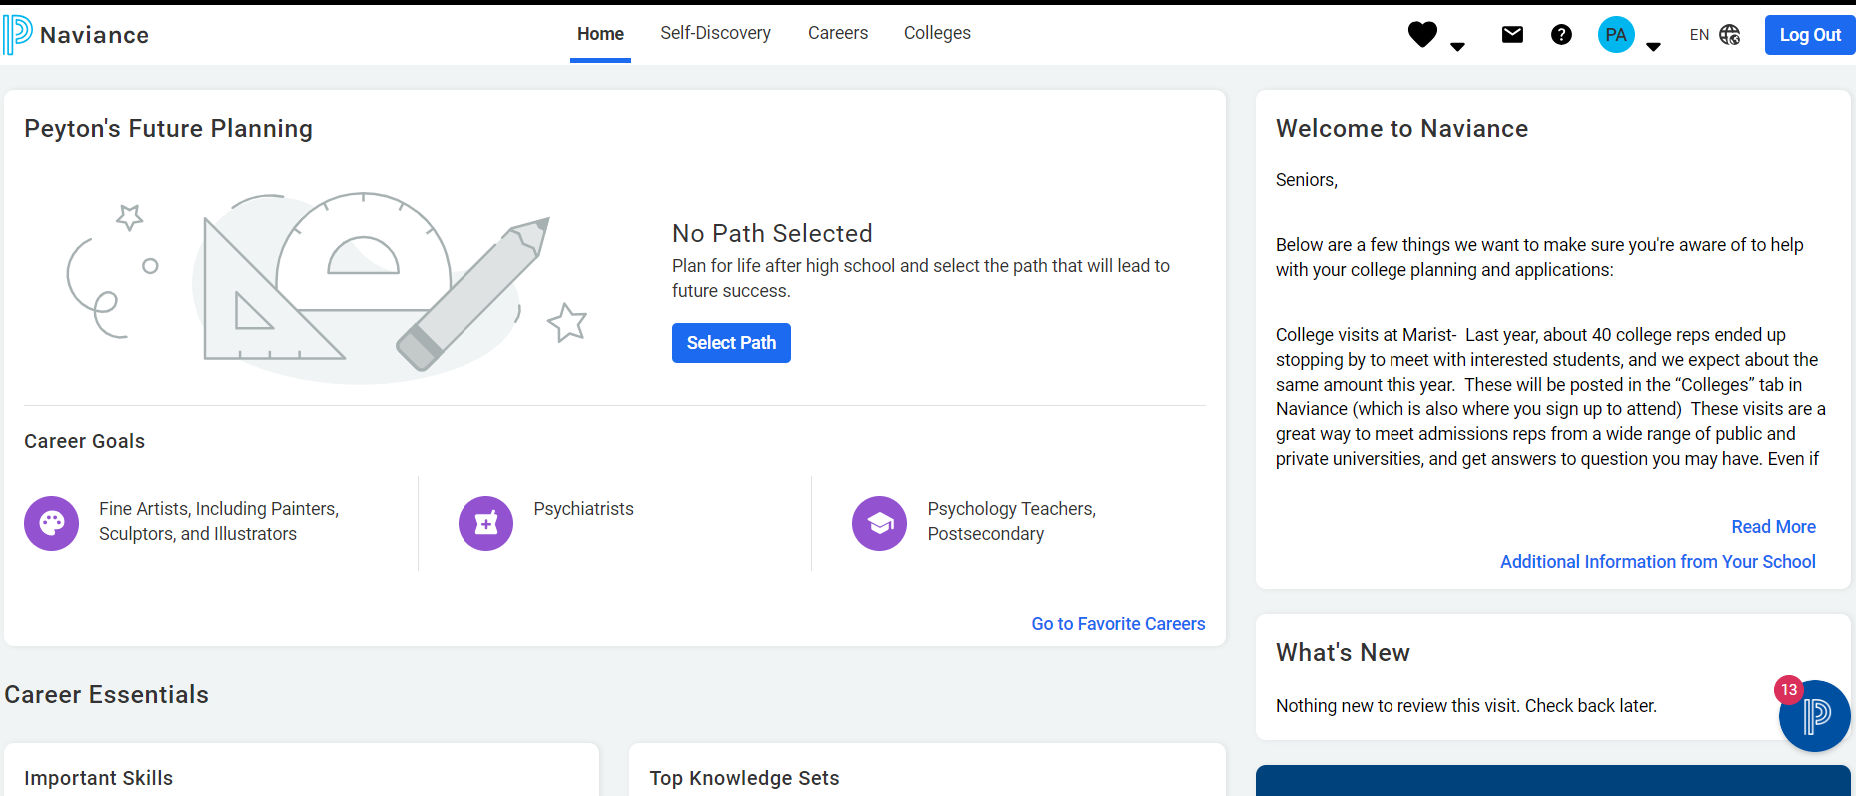
Welcome to Naviance MCHS

Slide 8
In Naviance, You will:
Complete your Teacher/Counselor Recommendation Survey
Continue to research colleges and careers
Add Colleges I’m Applying To (Actually applying to)
Request transcripts
Request letters of recommendation from teachers
Register for virtual/in person college visits “at” Marist
Match your Common App (IF Using)

Slide 9
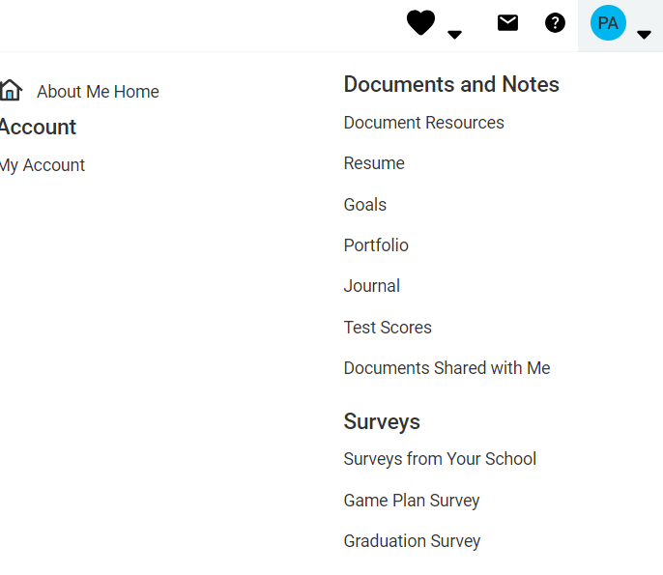

Slide 10
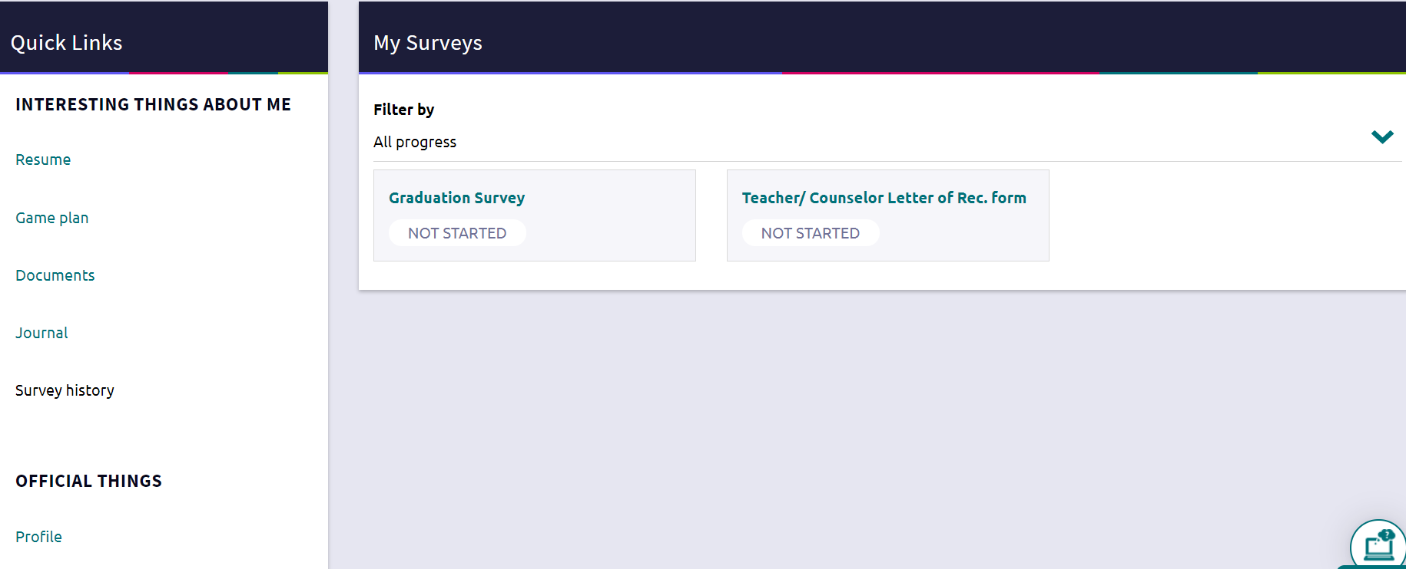
Teacher/Counselor Letter of Rec Form Survey

Slide 11
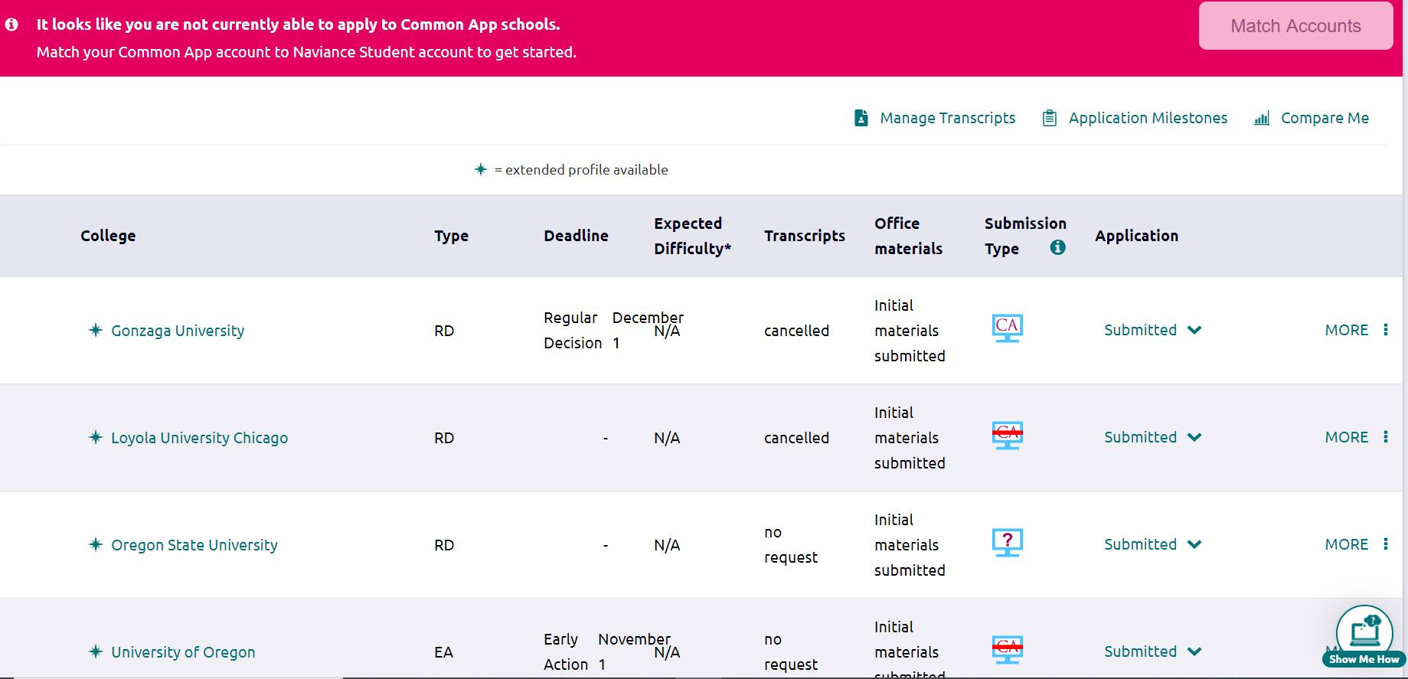
Colleges Applying To

Slide 12
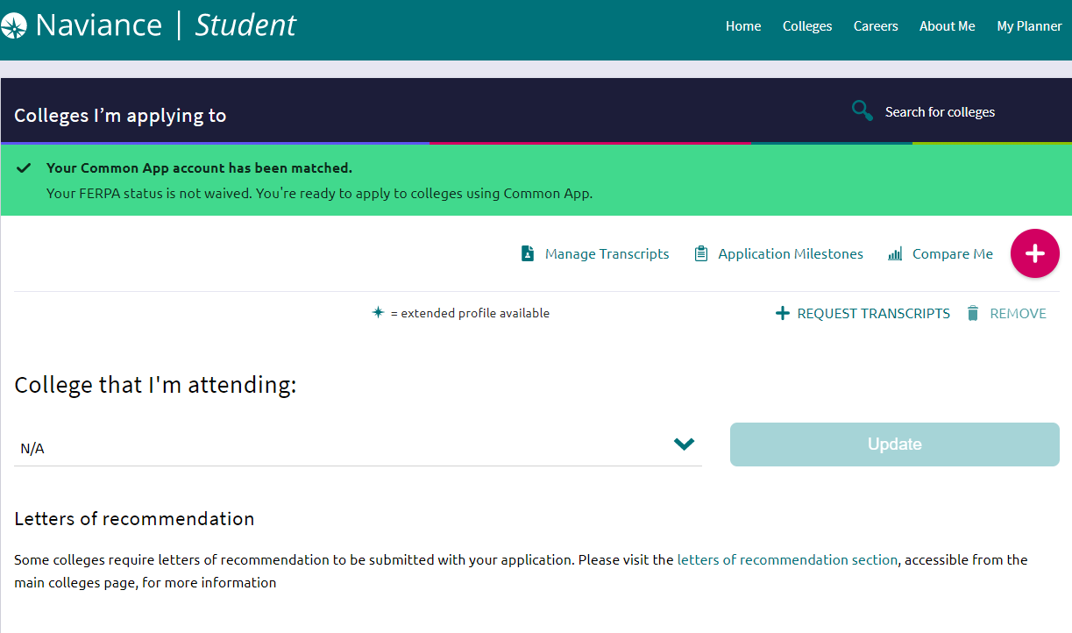
This is page where you will list your colleges and request transcripts to be sent.
Notes:
This should be done once you have submitted your application. Move from Colleges I ‘m Thinking about to Applying to

Slide 13
Common App FERPA Family Educational Rights & Privacy Act

Slide 14
Create College Organizational Tool
College | Major/Specific program | Deadline(s) | Essay | Test Scores/Sent | Letter(s) of Rec
OSU | Computer Sci, Math | EA- Nov 1st Prior— Reg— | Optional | Optional | Do not want recommendations from teachers/counselors
LMU | Engineering | EA- Nov 1st Prior |  |  | Counselor, 2 Teachers

Slide 15
Consider Fit
Focus on finding the right “fit” rather than fixating on a particular school or set of schools
Academic, Social, Financial, School Size, Accessibility, Community Fit
Factors in College Choice Based on Class of 2021 Exit Survey

Slide 16
Select One-Two of Each
Reach School
may not be accepted
Good Match School
should be accepted
Safe School
will most likely be accepted
Safe schools are only truly safe if you apply on time, they are within your family’s budget AND you really want to go there!!!

Slide 17
Types of Admission
Regular – apply by a given date, notified in the spring
Open/Rolling – Apply anytime, notified in as received and reviewed.
Early Action – Apply early, notified early…can accept or decline
Early Decision – Apply early, notified early… you must accept offer and withdraw all others! BINDING

Slide 18
INTERESTED IN AN OUT-OF-STATE PUBLIC UNIVERSITY
Western Undergraduate Exchange (WUE)
Study out of state in the West and pay only 150% of resident tuition. Choose from 150 institutions located in the 15 WICHE states.
These are competitive scholarships, but requirements vary greatly from school-to-school.
Visit www.wiche.edufor more information

Slide 19
Terminology visit the College Board Big Future website for explanation of these admission related terms. https://bigfuture.collegeboard.org/get-in/applying-101/college-admission-glossary
Admissions Tests- ACT/ SAT
Class Rank -Quintile
Coalition
Common App
College Now Credit (Dual Enrollment)
Deferred Admission
Early Action (EA)
Early Decision (ED)
Rolling Admissions
FAFSA/Financial Aid
Test Optional
Need Blind Admission
Priority Deadline
Official Transcript
Self Reported Grades
Undergraduate
Waitlist
Weighted GPA
Holistic Admissions

Slide 20
To Do List
Log into Naviance
If Using, Create Common App Account and Match CA to Naviance
Research Colleges in Naviance
Colleges I’m Applying to
Update Email and check regularly.
Check Naviance for scheduled virtual/in person visits
Check out the College Counseling page on the Marist website
If Athlete, register with NCAA--http://www.ncaa.org/student-athletes/future/how-register

Slide 21
To Do List (cont.)
Review your DEADLINES
Contact Teachers and request Recommendation letters in Naviance
Request Transcripts—
Request Test scores be sent to colleges- (Collegeboard SAT and ACT)
Clean up internet image (Facebook, Instagram, email, etc.)

Slide 22
Upcoming Events
Oct 9th Financial Aid Night for parents 7pm- 8:30pm Theatre
Separation Preparation for Parents – Spring
Senior Farewell Mass – May

Slide 23
Who Do I see for Help?
COUNSELORS
Shari Pimental - A-Kl
Jacob Copley – Km-Z
Sherril Acton - Registrar

Slide 24
Resources
MCHS College Counseling Website- http://counseling.marisths.org/
Naviance
College Board/BigFuture: www.collegeboard.org
Common App website—https://www.commonapp.org/
Coalition website--https://www.coalitionforcollegeaccess.org/
ACT—https://www.act.org/
Schoology
College Websites
College Admissions Counselors (email)
Notes:
p.5

Slide 25
Final Thoughts
Be organized
Don’t Procrastinate
Read carefully and follow instructions
Continue to gather information (visits/websites)
Be mindful of deadlines
Utilize all resources— ASK for HELP

Slide 26
OWN IT!!
*Accountability: A college-bound senior is responsible for accurately completing application components. Each senior should be submitting his/her application in a timely manner and requesting assistance as needed.
You Got This!! And we got you!!
Q & A

